Slide 1
This slide is hidden.
Insert the starting slides after this slide

Slide 2
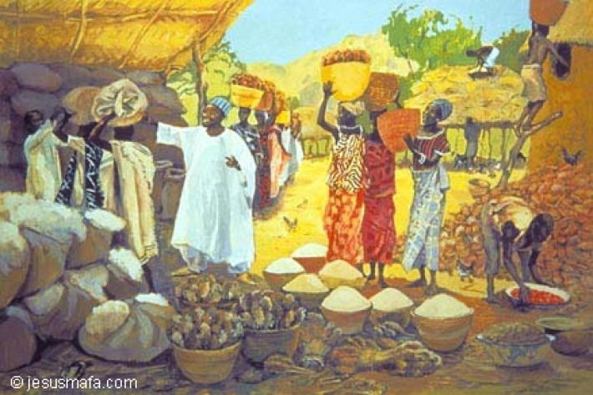
Welcome to St Michael’s
18th Sunday in Ordinary Time Year C
Please ensure all mobile phones are switched off.
Please be respectfully quiet as we prepare for our Celebration.
“Take care to guard against all greed, for though one may be rich, one’s life does not consist of possessions.”
Notes:
Saturday 5.30PM First Sunday of Advent
7am - 7th Sunday in Ord Time Year B

Slide 3
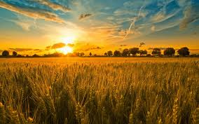
Then Jesus told them a parable…
“There was a rich man whose land produced a bountiful harvest. …

Slide 4
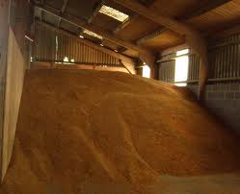
“What am I to, do? I have not enough room to store my crops.”

Slide 5
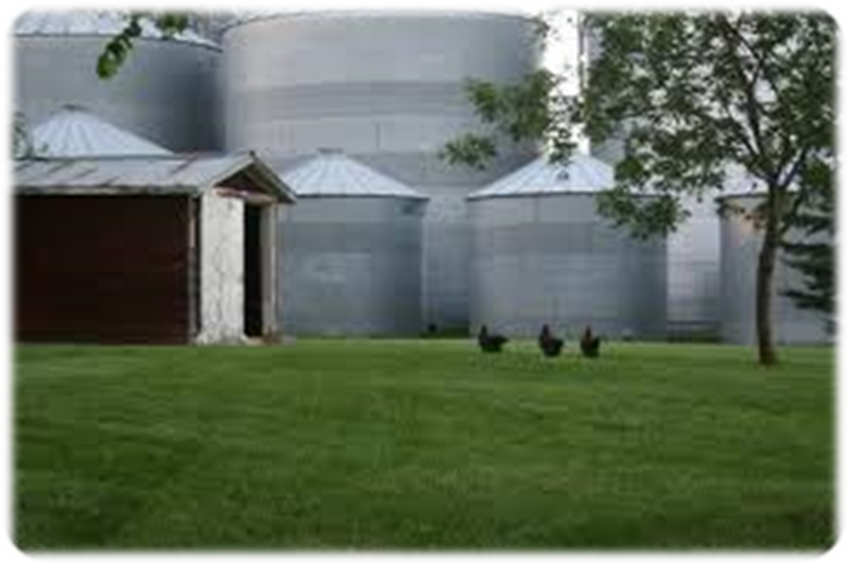
I will pull down my barns and build bigger ones, and store all my grain and my goods in them …

Slide 6
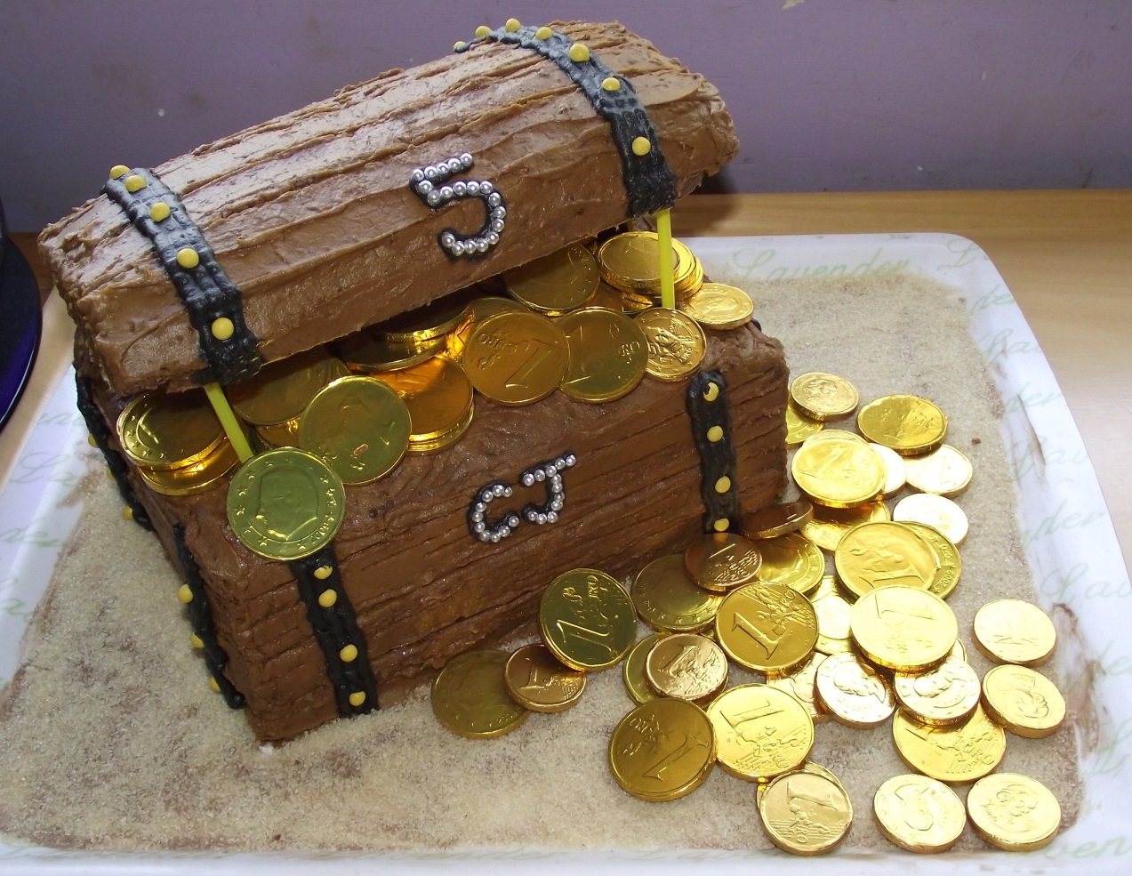
What treasures are you storing
up for yourself?

Slide 7
Please Stand

Slide 8
This slide is hidden.
Insert the Entrance Hymn after this slide

Slide 9
Praise the name of Jesus
Praise the name of Jesus
Praise him as we pray
Praise the name of Jesus
Sing to him all our days

Slide 10
From the rising of the sun
To the setting of the same
The name of the Lord is to be praised
In all things let's praise his name
And so let's

Slide 11
Praise the name of Jesus
Praise him as we pray
Praise the name of Jesus
Sing to him all our days

Slide 12
Let us come unto the Lord
Let us make a joyful noise
He has healed us through his word
In all things let's praise his name
And so let's

Slide 13
Praise the name of Jesus
Praise him as we pray
Praise the name of Jesus
Sing to him all our days
Sing to him all our days

Slide 15
Confiteor
I confess to almighty God
And to you, my brothers and sisters,
That I have greatly sinned
In my thoughts and in my words

Slide 16
In what I have done
And in what I have failed to do,
Through my fault,
Through my fault,
Through my most grievous fault;

Slide 17
Therefore I ask blessed Mary ever-Virgin,
All the Angels and Saints,
And you, my brothers and sisters,
To pray for me to the Lord our God.

Slide 19
Kyrie eleison
Kyrie eleison (2)
Christe eleison (2)
Kyrie eleison (2)

Slide 21
Gloria
Glory to God in the highest,
and on earth peace to people of good will.
We praise you, we bless you,
we adore you, we glorify you,

Slide 22
We give you thanks for your great glory,
Lord, God heavenly king,
O God, almighty father

Slide 23
Glory to God in the highest,
and on earth peace to people of good will.

Slide 24
Lord Jesus Christ, Only Begotten Son,
Lord God, Lamb of God, Son of the Father,
you take away the sins of the world,
have mercy on us;

Slide 25
you take away the sins of the world, receive our prayer;
you are seated at the right hand of the Father,
have mercy on us.

Slide 26
Glory to God in the highest,
and on earth peace to people of good will.

Slide 27
For you alone are the Holy One,
you alone are the Lord,
you alone are the Most High, Jesus Christ,
with the Holy Spirit,
in the glory of God the Father.

Slide 28
Glory to God in the highest,
and on earth peace to people of good will.
Amen.

Slide 30
Responsorial Psalm
In every age O Lord, you have been our refuge

Slide 32
Alleluia
Alleluia, alleluia,
alleluia, alleluia

Slide 34
Apostles Creed
I believe in God,
the Father almighty,
Creator of heaven and earth,
and in Jesus Christ, his only Son, our Lord,
(At the words that follow, up to and including the Virgin Mary, all bow.)

Slide 35
who was conceived by the Holy Spirit,
born of the Virgin Mary,
suffered under Pontius Pilate,
was crucified, died and was buried;
he descended into hell;

Slide 36
on the third day he rose again from the dead;
he ascended into heaven,
and is seated at the right hand of God the Father almighty;

Slide 37
from there he will come to judge the living and the dead.
I believe in the Holy Spirit,
the holy catholic Church,

Slide 38
the communion of saints,
the forgiveness of sins,
the resurrection of the body,
and life everlasting.
Amen.

Slide 40
First Collection
This collection goes to the Bishop
for the support of the Diocese.
Thank you for your contribution

Slide 42
This slide is hidden.
Insert the Offertory Hymn after this slide.

Slide 43
Blessed be God
Blessed are you Lord God or all creation
Thanks to your goodness this bread we offer
Fruit of the earth, work of our hands
It will become the bread of life

Slide 44
Blessed be God, blessed be God
Blessed be God forever amen.
Blessed be God, blessed be God
Blessed be God forever amen

Slide 45
Blessed are you Lord, God of all creation
Thanks to your goodness this wine we offer
Fruit of the vine, work of our hands
It will become the cup of joy

Slide 46
Blessed be God, blessed be God
Blessed be God forever amen.
Blessed be God, blessed be God
Blessed be God forever amen

Slide 48
Priest: Pray my brothers and sisters,
that my sacrifice and yours may be
acceptable to God, the almighty Father.
All: May the Lord accept the sacrifice
at your hands for the praise and glory of his name, for our good and the good of all his holy Church.

Slide 49
Priest: The Lord be with you.
All: And with your spirit.
Priest: Lift up your hearts.
All: We lift them up to the Lord.

Slide 50
Priest: Let us give thanks to the
Lord our God.
All: It is right and just.

Slide 52
Holy
Holy, Holy, Holy Lord God of hosts,
Heaven and earth are full of your glory. Hosanna in the highest
Blessed is he who comes
in the name of Lord,
Hosanna in the highest.

Slide 54
Memorial acclamation
Save us saviour of the world,
For by your cross and resurrection,
You have set us free

Slide 55
Memorial acclamation
When we eat this bread
And drink this cup
We proclaim your death O Lord
Until you come again

Slide 56
Memorial acclamation
We proclaim your death O Lord
And profess your resurrection
Until you come again

Slide 58
Amen
Amen, amen, amen, amen.
Amen, amen, amen, amen.

Slide 60
Priest: The Lord be with you.
All: And with your spirit

Slide 62
Peace
May the peace of the Lord be with you
With your friends and your family too
Let it be, let it grow
And everywhere you go
May the peace of the Lord follow you

Slide 63
Lamb of God
Lamb of God, lamb of God
You take away the sins of the world
Have mercy on us, lamb of God

Slide 64
Lamb of God, lamb of God
You take away the sins of the world
Have mercy on us, lamb of God

Slide 65
Lamb of God, lamb of God
You take away the sins of the world
Grant us, grant us peace

Slide 67
Priest: Behold the Lamb of God, behold him
who takes away the sins of the world.
Blessed are those called to the supper of the Lamb.
All: Lord, I am not worthy
that you should enter under my roof,
but only say the word
and my soul shall be healed.

Slide 68
This slide is hidden.
Insert the Communion Hymns after this slide.

Slide 69
This is my body
This is my body, broken for you
Bringing you wholeness, making you free
Take it and eat it, and when you do
Do it in love for me

Slide 70
This is my blood, poured out for you
Bringing forgiveness, making you free
Take it and drink it, and when you do
Do it in love for me

Slide 71
Take and eat
Take and Eat, Take and Eat,
This is my body given up for you.
Take and drink, Take and drink,
This is my blood given up for you.

Slide 72
I am the lamb that takes away your sin
I am the gate that guards you night and day
You are my flock; you know the shepherd's voice
You are my own; your ransom is my blood

Slide 73
Take and Eat, Take and Eat,
This is my body given up for you.
Take and drink, Take and drink,
This is my blood given up for you.

Slide 74
I am the cornerstone that God has laid
A chosen stone and precious in his eyes
You are God's dwelling place;
On me you rest
Like living stones, a temple for God's praise

Slide 75
Take and eat, take and eat
This is my body, given up for you
Take and drink, take and drink
This is my blood, given up for you

Slide 76
I am the light that came into the world
I am the light that darkness cannot hide
I am the morning star that never sets
Lift up your face
In you my light will shine

Slide 77
Take and eat, take and eat
This is my body, given up for you
Take and drink, take and drink
This is my blood, given up for you

Slide 78
I am the first and last, the living one
I am the Lord who died that you might live
I am the bridegroom, this is my wedding song
You are my bride, come to the marriage feast

Slide 79
Take and eat, take and eat
This is my body, given up for you
Take and drink, take and drink
This is my blood, given up for you

Slide 80
I will pilot thee
Sometimes when my faith would falter
And no sunlight I can see
I just lift mine eyes to Jesus
And I whisper ‘pilot me’

Slide 81
“fear thou not for I’ll be with thee,
I will still they pilot be,
Never mind the tossing billows,
Take my hand and trust in me”

Slide 82
Often, when my soul is weary
And the day seems oh so long
I just look up to my pilot
And iI hear this blessed song,

Slide 83
fear thou not for I’ll be with thee,
I will still they pilot be,
Never mind the tossing billows,
Take my hand and trust in me”

Slide 84
When temptations ‘round me gather
And I almost lose my way
Somehow, in the raging tempest,
I can hear my saviour say.

Slide 85
fear thou not for I’ll be with thee,
I will still they pilot be,
Never mind the tossing billows,
Take my hand and trust in me”

Slide 87
Second Collection
What you contribute now
is for the support of our
parish and its mission.
Thank you for your generosity

Slide 88
This slide is hidden.
Insert the Notices for the week after this slide

Slide 89
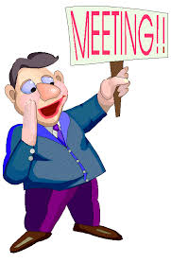
Parish Pastoral Council PPC
Wednesday, 7 August at 7.30pm in
Parish Meeting Room (Office)

Slide 90

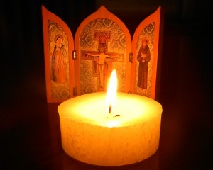
Wednesday 7 August – St Michael’s
6.30pm Holy Hour
7.30pm Mass
8.00pm Supper
National Vocations Awareness Week Aug 4 –11

Slide 91
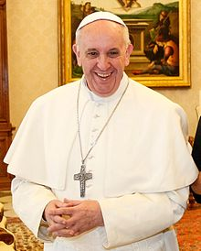
Pope Francis’
Prayer for Vocations
God our Father,
You make each of us
to use our gifts in the Body of Christ.
We ask that you inspire young people
whom you call to priesthood
and consecrated life
to courageously follow your will.
.

Slide 92
Send workers into your great harvest
so that the Gospel is preached,
the poor are served with love,
the suffering are comforted,
and Your people are strengthened
by the sacraments.
We ask this through Christ our Lord.
Amen

Slide 93

Please take home your bulletins or download it from
www.stmichaelsparish.com
  www.facebook.com/blacktowncatholics

Slide 94
This slide is hidden.
The next slide can be used for videos.
Insert the video into the slide.

Slide 96
Priest: The Lord be with you.
All: And with your spirit.

Slide 98
This slide is hidden.
Insert the Recessional Hymns after this slide.

Slide 99
It's no longer I that liveth
It's no longer I that liveth
But Christ that liveth in me
It's no longer I that liveth
But Christ that liveth in me

Slide 100
He lives, he lives
Jesus is alive in me
It's no longer I that liveth
But Christ that liveth in me

Slide 101
It's no longer I that liveth
But Christ that liveth in me
It's no longer I that liveth
But Christ that liveth in me

Slide 102
He lives, he lives
Jesus is alive in me
It's no longer I that liveth
But Christ that liveth in me

Slide 104
This slide is hidden.
Insert the final slide here.

Slide 105
What treasures are you storing
up for yourself?

